Slide 1

Blockchains
& Distributed Ledgers
Lecture 08
Aggelos Kiayias
Slide credits: AK, Dimitris Karakostas

Slide 2
Eponymous system
Each action can be attributed to a user’s real-world identity
Examples:
Facebook - posts/comments are linked with the real-world name of the user who made it
Tweeter blue check (pre-X) - accounts are verified w.r.t. real-world identification documents
UK parliament votes - the vote of each MP is (publicly) attributable to each

Slide 3
Pseudonymous system
Identities are represented as tags
Each tag is independently assigned to each identity
An identity may be assigned multiple tags and vice versa
Examples:
X/Reddit - posts/comments are linked to an (arbitrary) username
Email - each message is linked with an email address
Graffiti - each piece is signed by a tag/pseudonym (e.g., Banksy)
Sybil Attack:
The setting where a single operator manages multiple identities/pseudonyms in a system

Slide 4
Anonymous system
Any performed action is manifested within a set of indistinguishably-acting participants
The set of indistinguishable participants is called the anonymity set
Hide in public
Examples:
General election voting - e.g., 20,805 of 78,411 electorate voted Labour in 2024 Edinburgh North and Leith.
Tor browsing - website/hidden service sees only number of Tor connections (not name/IP)

Slide 5
Privacy in Bitcoin
Users can create multiple accounts/addresses:
without cost
without association to previous accounts
Essentially, users can create an unlimited number of pseudonyms

Slide 6
Transaction Graph Analysis
24.999
b
TX1
50 BTC
TX2
a
25
c
coinbase transaction
account a moves 50 BTC to accounts b and c (minus fees)

Slide 7
Transaction Graph Analysis
24.999
b
24.999
b
TX1
50 BTC
TX2
a
50
.
a
25
25
c
coinbase transaction
c
account a moves 50 BTC to accounts b and c (minus fees)

Slide 8
Common Behaviours
1
1
N
N-1
1
N-2
N-3
peeling chain
star

Slide 9
Fungibility and Privacy
Fungibility: Coins are interchangeable
However, each “satoshi” has its whole history in the Bitcoin blockchain
satoshi fungibility is debatable

Slide 10
Bitcoin’s privacy
Alice receives two payments of 50 BTC
Alice & Charlie receive two payments of 50 BTC
TX1
50 BTC
TX1
50 BTC
a
a
indistinguishable
“World A”
“World AC”
TX2
50 BTC
TX2
50 BTC
b
c
Two random variables are called (perfectly) indistinguishable if they produce any output with identical probability

Slide 11
Bitcoin’s privacy (or lack thereof)
In world A, Alice wishes to make a payment of 75 BTC
TX1
50 BTC
c
75
Given this observation,
an external third party can
conclude that it is
more likely to be in
“World A” instead of “World AC”
TX3
a
b
24.999
TX2
d
50 BTC

Slide 12
Transaction Anonymization Techniques

Slide 13
Anonymising Transactions - Centralized
tx₁
Trusted Party
tx_{n+1}
a
a₁
b₁
tx₂
tx_{n+2}
a₂
b₂
tx_{n}
tx_{n+m}
a_{n}
b_{m}

Slide 14
Anonymising Transactions - Centralized
tx₁
Trusted Party
tx_{n+1}
a
a₁
b₁
Anonymity set of size n
tx₂
tx_{n+2}
a₂
b₂
TP may disappear with the money
tx_{n}
tx_{n+m}
a_{n}
b_{m}

Slide 15
Anonymizing Transactions - CoinJoin
Without Coinjoin
Transaction 1
In: 20 BTC
Out: 15 BTC
Alice
Bob
Change
Out: 5 BTC
Transaction 2
In: 10 BTC
Out: 8 BTC
Charlie
David
Change
Out: 2 BTC

Slide 16
Anonymizing Transactions - CoinJoin
Without Coinjoin
With Coinjoin
Transaction 1
Coinjoin Transaction
In: 20 BTC
Out: 15 BTC
In: 20 BTC
Out: 15 BTC
Alice
Bob
Alice
Bob
Change
Change
Out: 5 BTC
Out: 5 BTC
Transaction 2
In: 10 BTC
Out: 8 BTC
Charlie
David
In: 10 BTC
Out: 8 BTC
Change
Out: 2 BTC
Charlie
David
Change
Out: 2 BTC

Slide 17
Multiple Input Transactions - Setup
Parties:
n participants
one designated leader
The i-th party sends to the leader:
the recipient address b_{i}
the return (change) address c_{i}
the corresponding amounts
When all n parties complete this step, the multiple input transaction is formed by the leader and sent to all n parties

Slide 18
Multiple Input Transactions - Sign and Publish
Each party sends a signature on the multiple input tx to the leader
When all n signatures are received, the multiple input tx is posted on the blockchain by the leader
If any of the n parties aborts the protocol, the transaction cannot be validated
If the leader is adversarial, transaction cannot be published/validated
Questions:
Can we ensure that an adversary does not correlate b_{i}, c_{i} ?
In case of an abort, is it possible to restart the protocol without the offending party?
Consider the following objectives; are they attained or not (and why)?
Denial of service protection
Loss of funds prevention
Privacy protection
Guaranteed termination

Slide 19
Passive vs Active Attacks
A passive adversary just observes the network and the blockchain
an anonymity set of size n for each participant, assuming equal amounts
An active adversary participates in a protocol execution
the correlation between participants will be apparent to the leader in the multiple input transaction (even if communication with the leader is performed via an encrypted channel)

Slide 20
Mix-net
A mix-net facilitates a sender-anonymous broadcast
Decryption mix-nets
Re-encryption mix-nets

Slide 21
Mix-net
S₁
m₁
R
A
C
m₁
m₂
S₂
m₂
B
D
Not possible to relate if S₁ sent m₁ or m₂ (and vice versa for S₂) - as long as there is one hornest mix.

Slide 22
Decryption Mix-net
Payload
destination / info
Encrypted with sym_key3
fixed
block
size 2
fixed slock size 1
Encrypted with Public key of C
Deliver to R; sym_key3

Slide 23
Decryption Mix-net
Encrypted with sym_key2
Payload
destination / info
Encrypted with sym_key3
fixed
block
size 1
Encrypted with Public key of B
Send to C; sym_key2
fixed
block
size 2
Encrypted with sym_key2
fixed
block
size 1
Encrypted with Public key of C
Deliver to R; sym_key3

Slide 24
Decryption Mix-net
fixed
block
size 1
Encrypted with Public key of A
Send to B; sym_key1
Encrypted with sym_key1
Encrypted with sym_key2
Payload
destination / info
Encrypted with sym_key1
Encrypted with sym_key3
fixed
block
size 1
Encrypted with Public key of B
Send to C; sym_key2
fixed
block
size 2
Encrypted with sym_key1
Encrypted with sym_key2
fixed
block
size 1
Encrypted with Public key of C
Deliver to R; sym_key3

Slide 25
Routing via a Mix-net
sender

Slide 26
Routing via a Mix-net
sender
noise
A
Decrypted data
Send to B; sym_key1

Slide 27
Routing via a Mix-net
sender
noise
noise
A
B
noise
Decrypted data
Send to C; sym_key2

Slide 28
Routing via a Mix-net
sender
noise
noise
A
B
noise
C
receiver
Decrypted data
Deliver to R; sym_key3

Slide 29
Mix-net for Coinjoin transactions
Parties share with all parties their public-keys (PKI setup)
the association between public-keys and accounts a₁, a₂, …, a_{n} is public
Parties engage in a decryption mix-net in sequence
the last party is the leader
obtains all the relevant information to assemble the multiple input transaction
the tx is then sent to all parties
Note that each step is performed by a designated party P_{i}
any abort is identifiable and can be attributed to P_{i}
a repeat session may exclude the offending party P_{i}
Parties send their signatures to the leader

Slide 30
Hiding Coin Balances
Coinjoin Transaction
In: 20 BTC
Out: 15 BTC
Alice
Bob
Change
Out: 5 BTC
In: 10 BTC
Out: 8 BTC
Charlie
David
Change
Out: 2 BTC
Balances are visible!

Slide 31
Mimblewimble
Use commitments with homomorphic property:
Com(x) * Com(y) = Com(x+y)
Instead of revealing the balance transferred, commit to it
Pedersen commitment
Hiding: commitment does not reveal any information about the value
Binding: user cannot open/reveal a value other than the committed
Ensure value preservation value via the homomorphic property
Com(x) * Com(-x) = Com(0)
Georg Fuchsbauer, Michele Orrù, Yannick Seurin. Aggregate Cash Systems: A Cryptographic Investigation of Mimblewimble

Slide 32
Coordination
CoinJoin and similar techniques require:
Coordination
Message passing between multiple parties
How do parties find each other?
How to prevent DoS attacks?
Is it possible to improve with more advanced cryptographic techniques?

Slide 33
Blind-Signatures
signing
protocol
signing
key (sk)
Signer
User
message
public
key (vk)
Signature σ that can be verified against m, vk
Signer doesn’t see the message
Signer cannot link two published (m, σ) with which users requested them
Notes:
Signer does not get the message
Signer cannot link two published m, σ with which users requested them

Slide 34
Chaum’s E-cash
Bank
Blind Signature
1. Show (blinded) E-coin, nonce, id
User
Shop
Notes:
Bank cannot correlate different $5 payments (cannot link withdrawal with redeeming)

Slide 35
Chaum’s E-cash
Bank
Blind Signature
1. Show (blinded) E-coin, nonce, id
2. sign_{$5-Bank}(E-coin, nonce)
User
Shop
Notes:
Bank cannot correlate different $5 payments (cannot link withdrawal with redeeming)

Slide 36
Chaum’s E-cash
Bank
Blind Signature
1. Show (blinded) E-coin, nonce, id
2. sign_{$5-Bank}(E-coin, nonce)
3. Show signed E-coin
User
Shop
Notes:
Bank cannot correlate different $5 payments (cannot link withdrawal with redeeming)

Slide 37
Chaum’s E-cash
Bank
Blind Signature
1. Show (blinded) E-coin, nonce, id
2. sign_{$5-Bank}(E-coin, nonce)
4. Verify E-coin is not spent
3. Show signed E-coin
User
Shop
Notes:
Bank cannot correlate different $5 payments (cannot link withdrawal with redeeming)

Slide 38
Chaum’s E-cash
Bank
Blind Signature
1. Show (blinded) E-coin, nonce, id
5. Validate E-coin’s structure and signature
2. sign_{$5-Bank}(E-coin, nonce)
4. Verify E-coin is not spent
3. Show signed E-coin
User
Shop
Notes:
Bank cannot correlate different $5 payments (cannot link withdrawal with redeeming)

Slide 39
Chaum’s E-cash
Bank
Blind Signature
1. Show (blinded) E-coin, nonce, id
5. Validate E-coin’s structure and signature
2. sign_{$5-Bank}(E-coin, nonce)
4. Verify E-coin is not spent
3. Show signed E-coin
User
Shop
6. Finalize payment
Notes:
Bank cannot correlate different $5 payments (cannot link withdrawal with redeeming)

Slide 40
Anonymizing Bitcoin Payments via E-cash
Trustee
Blind Signature
Trustee is trusted to honor its E-coins.
1. Give 1 BTC
Fair
swap
2. Receive E-Coin (worth 1BTC)
4. Verify E-coin has not been spent
5. Send 1 BTC
3. Show E-Coin
User
Shop
6. Receive service

Slide 41
Anonymous Credentials
Authority
Blind Signature
1. Show (blinded) credential, id
5. Validate credential’s structure and signature
2. sign_{Authority}(cred)
4. Verify credential has not been used
3. Show credential
User
Gateway
6. Receive service
Notes:
Bank cannot correlate different $5 payments (cannot link withdrawal with redeeming)

Slide 42
Fair Swaps
Alice and Bob would like to exchange secrets s.t.:
either none of them gets their output
or both do
Classical problem
Impossible to solve under standard network assumptions!
(intuition: one party always has the ``upper hand.’’)
Going around the impossibility:
optimistic fair exchange
Resort to a trusted third party, when things go bad.
resource-based fair exchange
Parties exchange puzzles in multiple rounds, so if one aborts and they can recover the other’s secret, the latter can also do that with a bit more effort.
fair swaps with penalties
In case of an abort, the aborting party has to pay a penalty.

Slide 43
Fair Swaps - Construction
Using a blockchain that supports smart contracts
A contract that both parties fund to accept their secrets
Key requirements:
parties lock up some funds in deposits
secret submission should be verifiable by the contract’s code
Fair swap with penalty:
Either both parties get their output
Or the offending party is penalized financially
Easier problem: Fair swap of tokens
Parties lock the required number of tokens in a smart contract that facilitates the swap in case all values are in. If not, it allows parties to withdraw after a timeout.

Slide 44
Anonymity and Digital Signatures

Slide 45
Anonymity and Digital Signatures
So far all digital signatures identify the signer
Is it possible to hide the sender within a group?

Slide 46
Group Signatures
member = Charlie
Group Manager
Opening Authority
Key directory
Alice: pk_{A}
Bob: pk_{B}
Charlie: pk_{C}
David: pk_{D}
Eric: pk_{E}
message
member
signature
Verifier
(is convinced that a member signed the message, but not which one)

Slide 47
Traceable Signatures
Charlie
Group Manager
Tracing Authority
Key directory
Alice: pk_{A}
Bob: pk_{B}
Charlie: pk_{C}
David: pk_{D}
Eric: pk_{E}
Opening Authority
(is convinced that a member signed the message, but not which one)
member
signature
Verifier
member
signature
Verifier
member
signature
Verifier

Slide 48
Ring Signatures
Key directory
Alice: pk_{A}
Bob: pk_{B}
Charlie: pk_{C}
David: pk_{D}
Eric: pk_{E}
message
member
signature
Verifier
(is convinced that a member of a subset (e.g., Eric, Frank, or Bob) signed the message, but not which one)

Slide 49
Monero/Cryptonote
Linkable ring signatures
“Stealth” addresses
For each payment, an anonymity set is selected with accounts of the same monetary value
A ring signature is issued on behalf of that set:
suitably restricted s.t. an account can only be used once
if an output is used twice, it is linkable and certain inferences can be made
Stealth addresses enable:
the sender to create unlinkable addresses for the receiver
the receiver to detect said addresses

Slide 50
Is Monero Anonymous?
There is potentially more uncertainty in the Monero blockchain compared to a Bitcoin-like blockchain (even with Coinjoin transactions)
However, it is not obvious how to quantify the level of anonymization
De-anonymization is feasible in reasonable real-world threat models
e.g., the attacker “sprays” the ledger with transactions s.t. it commands a good number of selected accounts

Slide 51
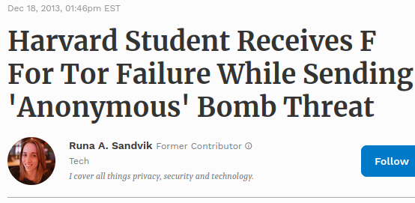
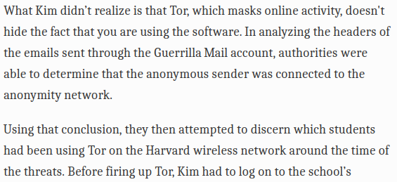
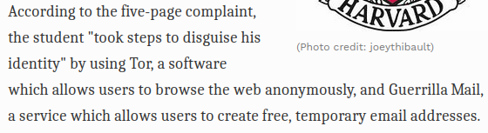

The revelance of the anonymity set

Slide 52
Increasing and Safeguarding the anonymity set
A larger anonymity set is most preferable
In the techniques seen so far, transaction preparation work increases linearly with the anonymity set
Ultimate Goal: use the set of all possible Unspent Transaction Outputs (UTxOs)

Slide 53
Increasing and Safeguarding the anonymity set
ρ, sn ψ = Commit(ρ, sn)
sn: the serial number of a valid $1 coin
ρ: random
The commitment value is associated with a ledger deposit
A coin for $1 is “minted”
Spending a coin requires announcing sn and proving it had been committed in the ledger:
existential quantifier over all ledger commitments
∃i : ψ_{ι} = Commit(ρ, sn)

Slide 54
Increasing and Safeguarding the anonymity set
Organize all commitments and serial numbers in a Merkle tree
Prove that there is a leaf in the Merkle tree that contains the commitment
ψ_{ι} = Commit(ρ, sn)
Statement representation and witness size logarithmic in the number of coins

Slide 55
Increasing and Safeguarding the anonymity set
Organize all commitments and serial numbers in a Merkle tree
Prove that there is a leaf in the Merkle tree that contains the commitment
ψ_{ι} = Commit(ρ, sn)
Statement representation and witness size logarithmic in the number of coins
Challenges
How to prove efficiently a statement referring to the leaf of a Merkle tree?
Possible solution: use “ZK-SNARKs”
SNARK: Succinct Non-interactive ARgument of Knowledge
How to transfer a coin from one user to another?
one cannot simply transfer ρ

Slide 56
Zero-knowledge

Slide 57
ZK-Snarks
Zero-knowledge succinct arguments of knowledge
Similar to “zero-knowledge proofs”
Can prove possession of a witness for any public statement / predicate
Computational soundness:
depends on the security of a “common reference string” (a structured cryptographic information that is assumed to be honestly sampled)
Succinctness:
the proof size and the verifier’s running time is efficient
proportional to the statement only

Slide 58
Constructing ZK-SNARKs
There exist a SNARK for any NP-relation R
NP = { L | exists R: x in L iff (x, w) in R; R is polynomial time}
The actual proof sizes are small (hundreds of bytes)
Verification does not depend on the running time of R

Slide 59
Zerocash
<vk, v, ρ> k = Commit(s, vk||ρ) sn = PRF_{sk} (ρ) vk = PRF_{sk} (0) ψ = Commit(s’, v||k) coin: (vk, v, ρ, s, s’, ψ)
(vk, sk): account’s public/private key
v: value, ρ: random (seed for serial number), s, s’: random (nonces for commitments)
PRF: pseudorandom function
Commit: commitment function The double commitment enables verifying that the value v is properly encoded in the coin (by opening ψ) without revealing vk, or sn (which is inside k)

Slide 60
Zerocash “Pour” Operation
Given a coin: (vk, v, ρ, s, s’, ψ)
Produce two new coins with values v₁ + v₂ = v
Use keys vk₁, vk₂
Serial number sn of spent coin is revealed and marked as spent
Set:
k_{i} = Commit(s_{i}, vk_{i}||ρ_{i}), i=1, 2
ψ_{i} = Commit(s_{i}’, v_{i}||k_{i}), i=1, 2
Show ψ₁, ψ₂ and sn and prove
ψ₁, ψ₂ are well formed
Prove Merkle tree contains some coin (vk, v, ρ, s, s’, ψ)
Check that serial number satisfies sn = PRF_{sk} (ρ) and vk = PRF_{sk} (0)
Value is split properly v₁ + v₂ = v, against the committed values in ψ₁, ψ₂
Encrypt s_{i} , s_{i}’ , ρ_{i} with the key of the recipient of the coin.
System checks sn is not spent and proof is correct. Merkle tree is updated

Slide 61
Common Reference Strings
SNARKs require a “common reference string”
A trusted computation is needed to produce it
Use secure multiparty computation (MPC)
Use updateable reference strings (URS) instead and outsource the update operation to miners/blockchain participants
Use alternatives to SNARKs that do not require it
Disadvantage: worse performance
e.g., Bulletproofs

Slide 62
Network security

Slide 63
Overlay Networks
A reliable network is critical for blockchains and distributed ledger protocols to operate
Typically they utilize an overlay network
a network built on top of another network
virtual links connect the participating nodes

Slide 64
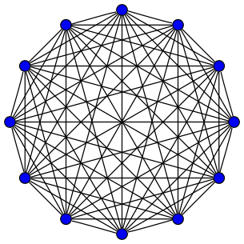
Overlay Networks
in a network, we would like
nodes to be fully connected
relevant operations :
point-to-point communication
broadcast

Slide 65
Network Requirements
Synchronicity
Reliable message transmission
Reliable Broadcast

Slide 66
Bitcoin’s P2P Network
A Peer-to-Peer (P2P) network over TCP/IP
Peers are identified by their IP address
Peers can diffuse messages to be propagated to the whole network
Peers initiate a small number of outgoing connections
Peers receive a limited number of incoming connections

Slide 67
Public vs. Private networks
A system with a public IP “lives” in the Internet
A system with a private IP “lives” in a private network and communicates with the Internet via a router that performs Network Address Translation (NAT)

Slide 68
P2P Networks
(In the case of Bitcoin) The requesting node contacts a DNS Seeder:
A node with a public IP address that can serve a list of IP addresses for Bitcoin nodes
Obtains those addresses via crawling
If the connection fails, the node has a hardcoded set of IP addresses
Peers exchange node IP addresses via ADDR messages that contain a selection of a peer’s address book

Slide 69
Table maintenance
Nodes maintain tables of peers that they have learned:
Nodes that have proven to be operational
Nodes for which the node has been informed about their existence, but they have not been contacted yet
Tables are updated on a regular basis
Timestamp information is stored from the last connection attempt

Slide 70
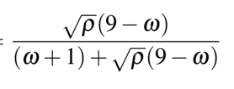
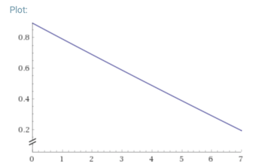
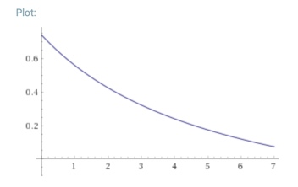
Connect to new or tried peers?
Tables “new” and “tried”
A node with ω ∈ {0, ..., 7} outgoing connections will select the ω+1 connection from tried with probability:
ρ: ratio between #(addresses in tried) and #(addresses in new)
Choose from the selected table an address to connect, biasing towards addresses with fresher timestamps
ρ=0.9
ρ=0.1

Slide 71
Attacking the P2P layer - Key Observations
A node will add an address to the ‘tried' table if it receives an incoming connection from another node
A node will accept unsolicited ADDR messages; these will be added to the ‘new’ table
Nodes rarely solicit information from DNS seeders and other nodes

Slide 72
Eclipse Attack
Victim is a node with a public IP
Attacker makes outgoing connection to the node using adversarial nodes
‘tried’ table gets full with fresh adversarial IP’s
Attacker uses ADDR messages to insert trash IP’s into the ‘new’ table of the victim
Attacker waits for the victim node to restart (nodes maintain existing outgoing connections)
Restarts can happen because of a software update or even deliberately by the attacker via a DOS attack

Slide 73
Eclipse Attack
The attacker can repetitively connect to victim node to ensure timestamps of adversarial nodes are fresh
If a ‘new’ address is selected:
injection of trash IPs ensures that, with some probability, the new node will not be responsive
another coin flip will be attempted for the connection, which can result to an adversarial IP

Slide 74
Eclipse Attack
Attacker saturates the incoming connections of the victim
The protocol allows for the same IP to occupy all 117 incoming TCP/IP connections
It becomes impossible for other nodes to connect to the victim
As maximum number of connections is reached, the victim will deny any other incoming connections

Slide 75
Eclipse Attack
Once the eclipse takes place, all (incoming/outgoing) communication of the victim is routed via the attacker nodes
victim’s transactions may be censored
victim’s blocks can be dropped
victim’s blockchain could be populated almost entirely by adversarial blocks!
The rest of the network will eventually completely forget about the victim node
a function isTerrible is executed periodically on the tables to remove any node that has an over-30-days old timestamp and too many failed connection attempts

Slide 76
Attack Countermeasures
Many mitigation techniques can be used:
ban unsolicited ADDR messages
diversify incoming connections
test before evicting addresses from the tried table
The possibility of an attack cannot be zeroed

Slide 77
Information propagation in Bitcoin
node
Inventory message: “I have data for you”
node
Field Size | Description | Data type | Comments
4 | type | uint32_t | Identifies the object type linked to this inventory
32 | hash | char[32] | Hash of the object

Slide 78
Information propagation in Bitcoin
getdata message: “I want data”
node
node
reply: “here is the data”
20-minute window before connection is dropped

Slide 79
Man-in-the-Middle attacks
Attacker
node
node
If attacker manipulates message contents on either direction, it can delay information propagation by 20 minutes.
Such delays can be extremely detrimental for security

Slide 80
Network partitioning attacks
Internet traffic is routed via the Border Gateway Protocol (BGP)
BGP is the primary interdomain routing protocol
Paths between networks need to be updated constantly, as the Internet is an evolving infrastructure
BGP is run by Internet Service Providers and other large networks that are connected
Participating nodes are called autonomous systems (AS)

Slide 81
BGP Highjacking
An attacker running an AS, can announce it can route a certain network path
no actual validation performed of such announcements
a malicious AS can even advertise a non-existent path
Bitcoin traffic can be filtered by the malicious AS
Downside: such attacks leave evidence in routing tables
More advanced attacks exist
Erebus

Slide 82
Network partitioning due to software error
A software upgrade causes upgraded clients to drop old blocks and vice versa
Example: bitcoin version 0.8 in March 2013
older clients were forced into their own chain

Slide 83
Wallets

Slide 84
Full nodes
Some wallets maintain the whole blockchain
Full nodes:
Keep the whole blockchain history (~187 GB)
Keep the whole UTxO set
Verify each tx
Verify each block
Relay every tx and block

Slide 85
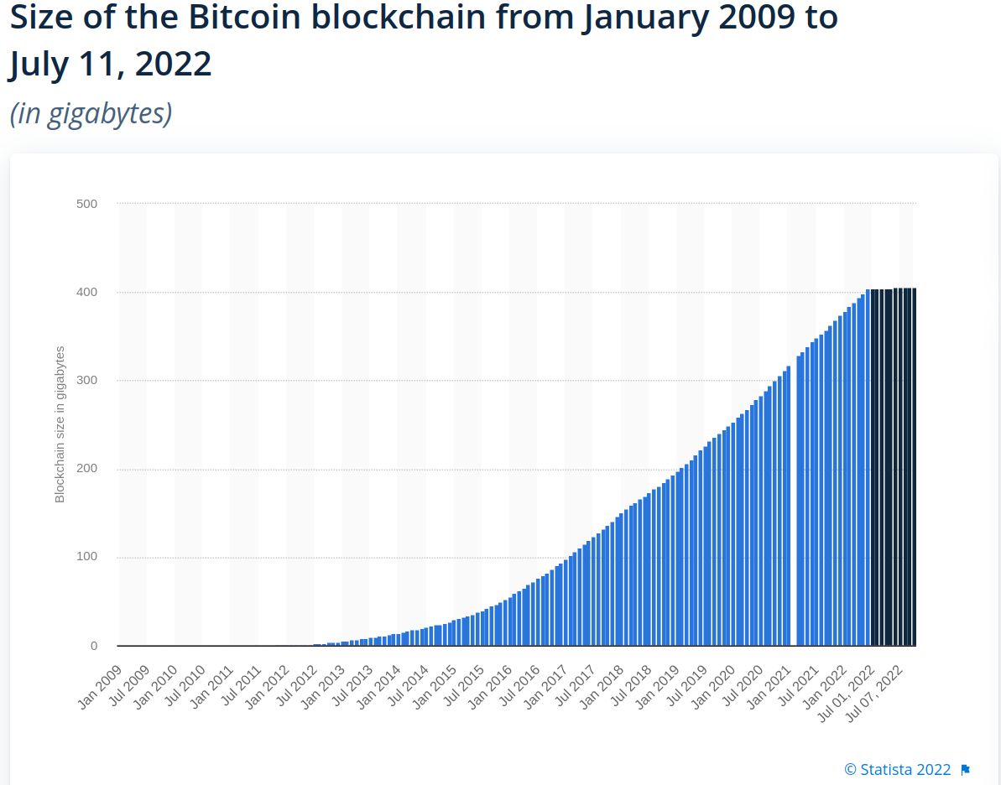

Slide 86
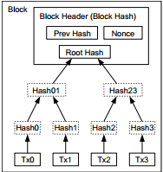
Recall : Merkle trees of transactions
Transactions not yet confirmed, but received by a full node are collected into a data structure called the mempool
To build a block, the mempool transactions are collected into a Merkle Tree in an (arbitrary, but valid) order defined by the miner
The application data in the block header, for which the Proof-of-Work equation is solved, only contain the root of this Merkle Tree: x

Slide 87
Advantages of using a Merkle tree
Proof-of-Work difficulty does not depend on the number of confirmed transactions
each miner is incentivized to include all transactions they can, which have a non-zero fee
The PoW difficulty only depends on the target T
this allows better control of the mining rate
It enables SPV wallets!

Slide 88
SPV
Simple Payment Verification
A different type of wallet
Useful for mobile, laptops etc.
Doesn’t need to download the whole blockchain
Does not download all transactions
Much faster than standard (full) node
Keeps only the block headers from genesis till today
Connects to multiple untrusted servers
Server is a full node which proves to the SPV wallet each claim

Slide 89
SPV
Wallet sends to the SPV server the bitcoin addresses they have
Not the private keys!
The SPV server knows which transactions to send to the SPV client
The addresses are shared via a Bloom filter
Wallet verifies each block’s PoW and authenticated ancestry
Keeps a longest chain as usual
Does not keep transactions
Wallet verifies each transaction it receives
Signatures
Law of conservation
Wallet verifies that the transaction belongs to the Merkle Tree root of a block

Slide 90
SPV Security
SPV wallets
don’t keep a UTXO
don’t verify or receive transactions they are not interested in
don’t verify coinbase validity
Have the same level of security as a regular full node
assuming honest majority
What can a malicious SPV server achieve?
Temporary fork to invalid block (invalid coinbase, transactions, non-existing UTXO, double spending...)

Slide 91
Wallet seeds and HD wallets
Hierarchical Deterministic (HD) wallet
An infinite sequence of wallet private keys can be generated from a single “master private key” (BIP-32)
A private key can be encoded as a human-readable seed
Seed is sufficient to recover all the private keys of a wallet
Typically backed up on paper
Optionally encrypted with password
Seed Example: deal smooth awful edit virtual monitor term sign start home shrimp wrestle

Slide 92
Wallet classification
wallets
hot
cold

Slide 93
Hot and cold wallets
Keys on an Internet-connected computer: Hot wallet
Easy to use
Can always spend my money immediately
Private keys offline: Cold wallet
Kept on a computer not connected to the Internet or a hard drive
Keys cannot easily be stolen
Keys can be moved to a hot wallet when needed to spend
User can see balance and how much money they have using public keys kept (safely) online

Slide 94
Other ways to store cold wallets
Paper wallet
Private key is printed on a piece of paper
Can optionally be encrypted with a secret password (which is remembered)
Brain wallet
Private key is SHA256(“my dog’s name is Barbie”) or some other passphrase
Full private key can be recovered by memory
Extremely unsafe!
More than $100,000 stolen due to low entropy passwords

Slide 95
Hardware wallets
Special hardware device used to store private keys
Most popular ones: Trezor, Ledger
Cold wallet
Connects to a computer via USB
Keys never leave the device
Device signs transaction and sends it to computer
When transacting, addresses are verified by looking at a screen
As hardware/software is specialized, much harder to “hack” or have bugs
Works safely even if host computer is compromised
Host can censor transactions! (eclipse)
Protected by a pin in case of theft
Can be backed up into paper and/or other hardware wallets

Slide 96
Wallet classification
wallets
hot
cold
Personal computer
hard drive
brain
paper
hardware
smartphone

